Slide 1
System Programming
UNIX File Systems
Chapter Two
Unix File Systems

Slide 2
UNIX File System
The file system is your interface to:
  physical storage (disks) on your machine
  storage on other machines (NFS)
  İnput/output devices
  etc.
Everything in Unix is a file (programs, text files, peripheral devices, terminals, …)
Directory is a file to contain (references to) other files
There are no drive letters in Unix! The file system provides a logical view of the storage devices
Chapter Two
Unix File Systems

Slide 3
Working Directory
Working directory: your current position the file system
pwd (print working directory) command outputs the absolute path (more later) of your working directory
Unless you specify another directory, a command will assume that you want to operate within the working directory
Chapter Two
Unix File Systems

Slide 4
Home Directory
Home directory: personel user space
At login, your working directory will be set to your home directory
The path (more later) to your home directory can be referred to by the (tilde) symbol
The home directory of user1 can be referred to by ~user1
Chapter Two
Unix File Systems

Slide 5
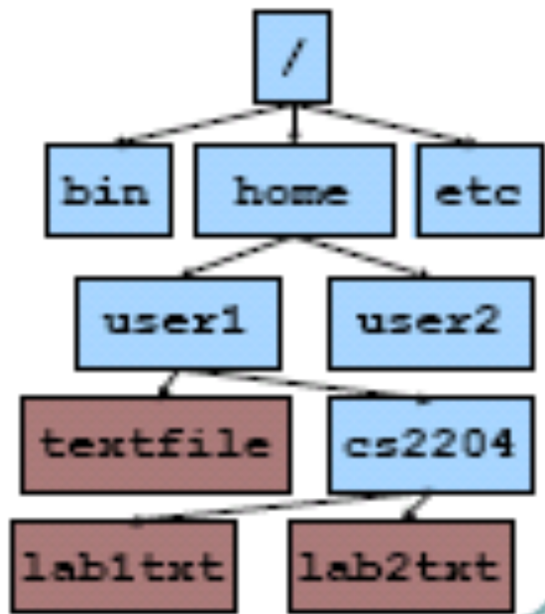
Unix File Hierarchy
Root directory: /
Directories may
contain plain files
or other directories
Result is a tree
structure for the
file system
Unix does not recognize any special filename extensions
Chapter Two
Unix File Systems

Slide 6
Unix Paths
Separate directories
by /
Absolute Path
  start at the root and
  follow the tree
Examples:
  /home/user1/textfile
  ~user1/textfile
  ~/textfile
Chapter Two
Unix File Systems

Slide 7
Unix Paths (cont.)
Relative Path
  start at working
  directory
  .. – level above
  . – working directory
Examples:
  textfile
  cs2204/labltxt
Chapter Two
Unix File Systems

Slide 8
Some Standard Directories
/ – root directory
/bin – standard commands and utilities; executables
/dev – block and character device directory
/etc – host-specific configuration; host services
/home – users’ home directories
/lib – library directory for various languages
/sbin – system commands and utilities (needed to boot)
/tmp – temporary files
/usr – user utilities and applications; /usr/local/
/var – system files that vary (logs, spools, email)
Chapter Two
Unix File Systems

Slide 9
Changing Directories
cd – changes the working directory
  cd <directory path>
  can use absolute or relative path names
  cd without any arguments is the same: cd ~
  Examples:
    cd /home/user1
    cd ../../user1
Chapter Two
Unix File Systems

Slide 10
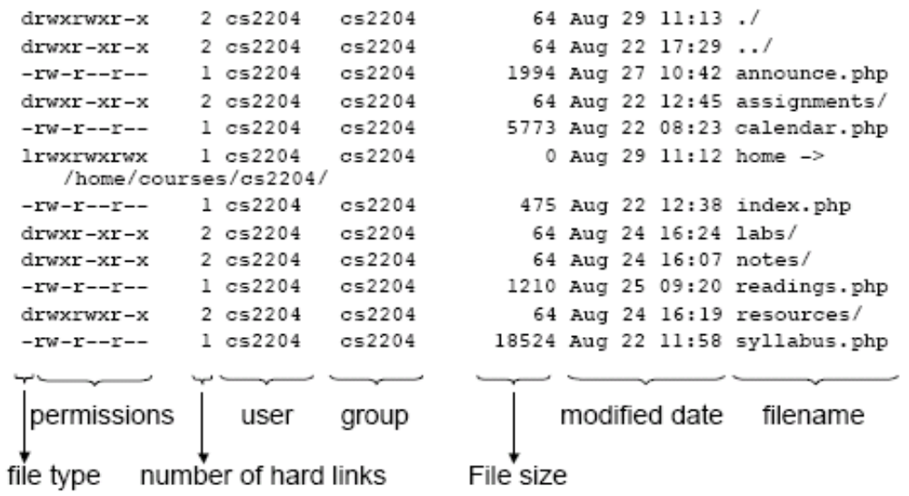
Partial Output of ls -lFa
Chapter Two
Unix File Systems

Slide 11
Types of Files
Plain ( – )
  Most files, binary or text
Directory ( d )
  Directory is actually a file
  Points to another set of files
Link ( l ):
  Pointer to another file or directory
Special:
  b – block device (disks, CD-ROM)
  c – character device (keyboard, joystick)
Chapter Two
Unix File Systems

Slide 12
Manipulating Files
touch <file>
  create a new file or change last modified date
mv <file1> <file2>
  Rename file1 as file2
mv <file1> <dir>
  move file1 into the dir directory
mv <file1> <dir/file2>
  move file1 into dir and rename as file2
cp <file1> [<file2>|<dir>|<dir/file2>]
  copy file with new name into directory, or both
rm [-i] <file(s)>
  remove file or list of files
Chapter Two
Unix File Systems

Slide 13
Creating and Removing Directories
mkdir <directory_name>
  create a subdirectory of the current directory
rmdir <directory_name>
  remove directory
  only works for empty directories
rm –r <directory_name>
  remove directory and all of its contents, including subdirectories, recursively (-r)
Chapter Two
Unix File Systems

Slide 14
Creating Links
ln –s <existing_file> <link_name>
  creates a symbolic link (-s)
  link_name is a pointer to existing file, which may be in another directory or even on another physical machine
  omit –s to create a hard link – must be in same physical partition of same device; link_name is another name for existing_file
Chapter Two
Unix File Systems

Slide 15
File Ownership
Each file has a single owner
chown command can be used to change the owner; usually only root can use this command
Each file also belongs to a single group
Groups may have different permissions than everyone else
Chapter Two
Unix File Systems

Slide 16
File Permissions
Permissions used to allow or disallow access to files or directories
Three types of permission:
  Read ( r )
  Write ( w )
  Execute ( x )
Permissions exists on three levels
  User ( u )
  Group ( g )
  World (o )
Chapter Two
Unix File Systems

Slide 17
File Permissions (cont.)
chmod <mode> <file(s)>
  chmod 700 textfile
  rwx rwx rwx
  user group world
  chmod g+rw textfile
  ugo +/- rwx
  g+rw changes permissions to 760 (octal)
Chapter Two
Unix File Systems

Slide 18
File Modification Date
Last time a file was changed
Useful when ...
  there are many copies of a file
  many users are working on a file
touch command can be used to update the modification date to the current date (or to create a file if it does not yet exist)
Chapter Two
Unix File Systems

Slide 19
Looking at File Contents
cat textfile1 textfile2
  short for concatenate
  output the contents of textfile1, then the contents of textfile2
less/more textfile
  scroll through textfile one screen at a time
  allows forward and backward scrolling and searching
Chapter Two
Unix File Systems

Slide 20
Wildcards in File Names
All of the commands covered here that take file names as arguments can also use wildcards
  * for any string, e.g. *txt,obj*,a*.*
  ? for any character, e.g. doc?
  [] around a range of characters, e.g.
[a-c]*
Chapter Two
Unix File Systems

Slide 21
Getting Help on UNIX Commands
man <command_name>
  shows all of the documentation for a command (less-style output)
apropos <keyword>
  shows you all of the commands with the specified keyword in their description
locate <string>
  shows files whose absolute path contains string
Chapter Two
Unix File Systems

Slide 22
Other File Systems
SunOS has 3 different types of file systems
  disk-based
  distributed
  pseudo
The disk-based file systems include hard-disks,CDROMs, diskettes.
The distributed file systems manage network resources.
The pseudo file systems are memory-based and do nor use any disk space.
Chapter Two
Unix File Systems

Slide 23
Other File Systems (cont.)
Disk-based file systems
  ufs
    UNIX File System, based on BSD Fat Fast File System (default)
  hsfs
    High Sierra File System, used by CDROMs. Very similar to ufs, except that it does not support writable media or hard links
  pcfs
    PC File System, to allow read/write access to DOS formatted disks
  cachefs
    Cache File System, allows use of local disk to store frequently accessed data from a remote file system or CDROM
Chapter Two
Unix File Systems

Slide 24
Other File Systems (cont.)
Distributed file systems
  nfs
    Network File System, the default distributed file system type
  rsfs
    Remote File Share, AT&Ts RFS product
  autofs
    Automount File System, automounts NFS file systems, as needed, using NIS and NIS+ maps
Chapter Two
Unix File Systems

Slide 25
Other File Systems (cont.)
Pseudo file systems
  tmpfs
    Temporary File System, file storage in memory and swap without the overhead of writing to a ufs file
  specfs
    Special File System, allows access to the special character and block devices
  lofs
    Loopback File System, creates a virtual file system which can overlay or duplicate existing files
  tfs
    Translucent File System, allows mounting of a file system on top of existing files, with both visible
Chapter Two
Unix File Systems

Slide 26
Other File Systems (cont.)
  procfs
    Process Access File System, allows access to active processes and their images
  fdfs
    File Descriptor File System, allows access to file names using descriptors
  namefs
    Name File System, used by STREAMS for dynamic mounts of file descriptors on top of files
  fifos
    First In First Out File System, allows process access to named pipe files
  swapfs
    Swap File System, used by the kernel to manage swap space
Chapter Two
Unix File Systems

